Slide 1

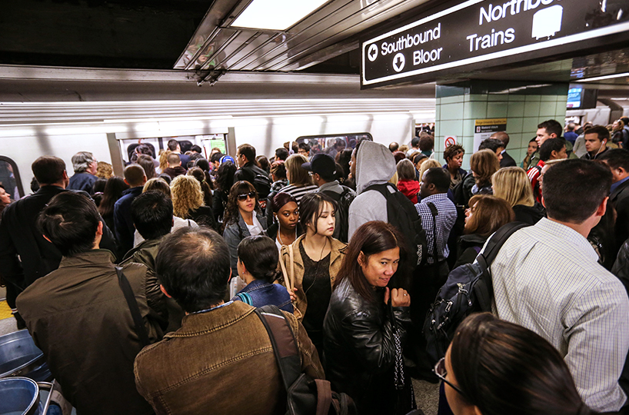
Time Series Analysis of TTC
Don Nguyen

Slide 2
Data Acquisition and Wrangling
Toronto’s Open Data
19 .csv files spanning over 5 years
No missing data for relevant features
Relevant columns limited to data and total number of delays
Date | Delay
2014-01-01 | 28
2014-01-02 | 31
2014-01-03 | 25
2014-01-04 | 13
2014-01-05 | 15

Slide 3
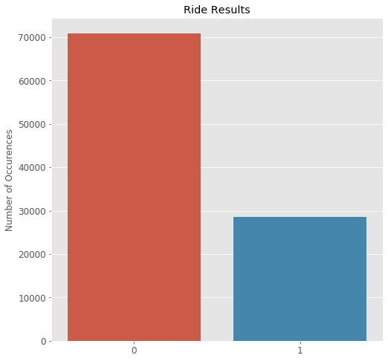
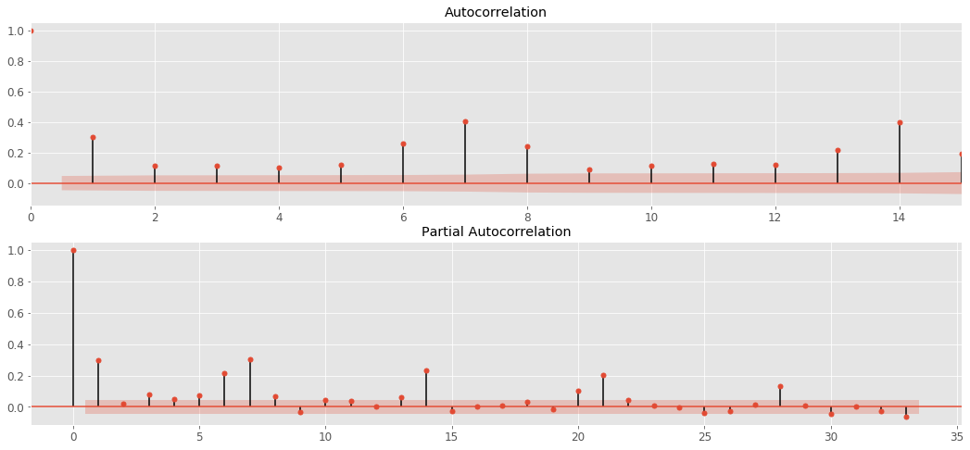
Exploratory Data Analysis

Slide 4
Model Comparison
Baseline
RMSE score = 8.51
ARIMA
RMSE score = 5.91
FB Prophet
RMSE score 5.39

Slide 5
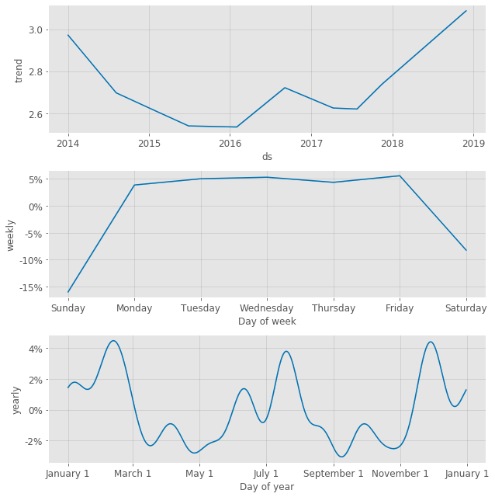
FB Prophet Components
Decreasing for first half of time period
Steadily increasing trend for second half
Weekly seasonality corresponds to work week for the average commuter
Peaks in winter and summer
Dips during spring and fall

Slide 6
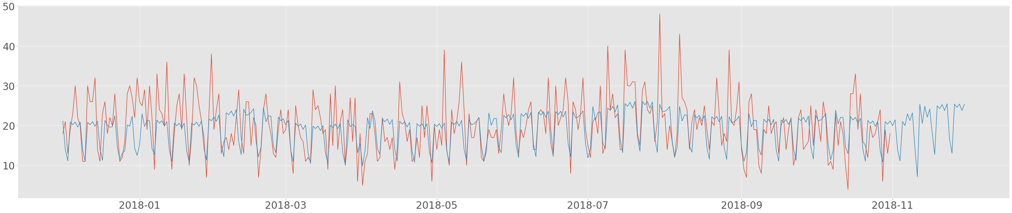
Predictions in blue, and actual data in red
Model underestimates the peaks but captures the dips quite well
Several peaks were due to natural disastors.

Slide 7
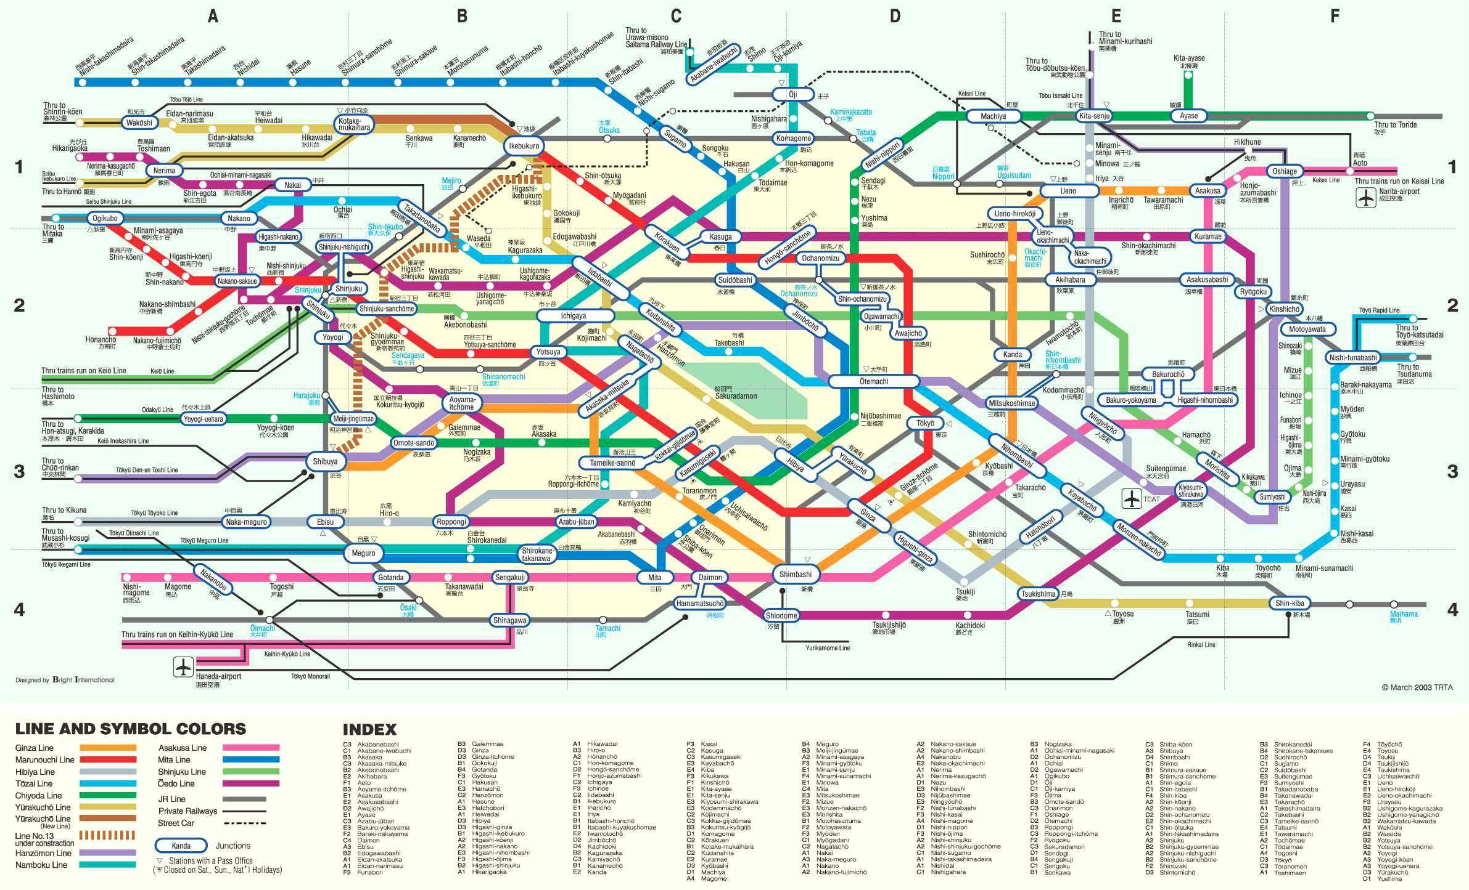
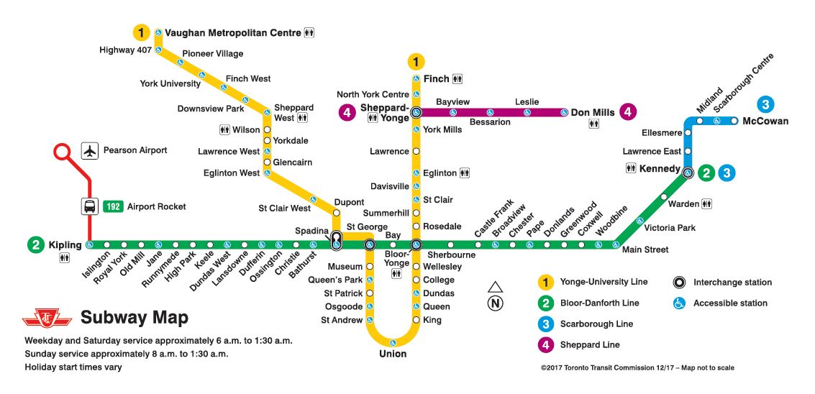
Suggestions
Consider AI assisted subway cars similar to Japan’s current system
Increase security and first responders during seasonal peaks

